Slide 1
Design of Synchronous (mod-n) counters.
(Lecture 8-10)

Slide 2
Counter
Definition:
A Counter is a device which stores (and sometimes displays) the number of times a particular event or process has occurred, often in relationship to a clock signal. Counters are used in digital electronics for counting purpose, they can count specific event happening in the circuit.

Slide 3
Types of Counter
Asynchronous Counters:
Only the first flip-flop is clocked by an external clock. All subsequent flip-flops are clocked by the output of the preceding flip-flop.
Asynchronous counters are slower than synchronous counters because of the delay in the transmission of the pulses from flip-flop to flip-flop.
Asynchronous counters are also called ripple-counters because of the way the clock pulse ripples it way through the flip-flops.

Slide 4
Continue…
Synchronous Counters:
All flip-flops are clocked simultaneously by an external clock.
Synchronous counters are faster than asynchronous counters because of the simultaneous clocking.
Synchronous counters are an example of state machine design because they have a set of states and a set of transition rules for moving between those states after each clocked event

Slide 5
Design Mod – N synchronous Counter
The value of N can be different from power of 2. Also, the counting sequence may be random for example some cyclic code (8421, 2423 etc). The following method is applied for designing for mod N and any counting sequence.
Design for Mod-N counter :
The steps for the design are:

Slide 6
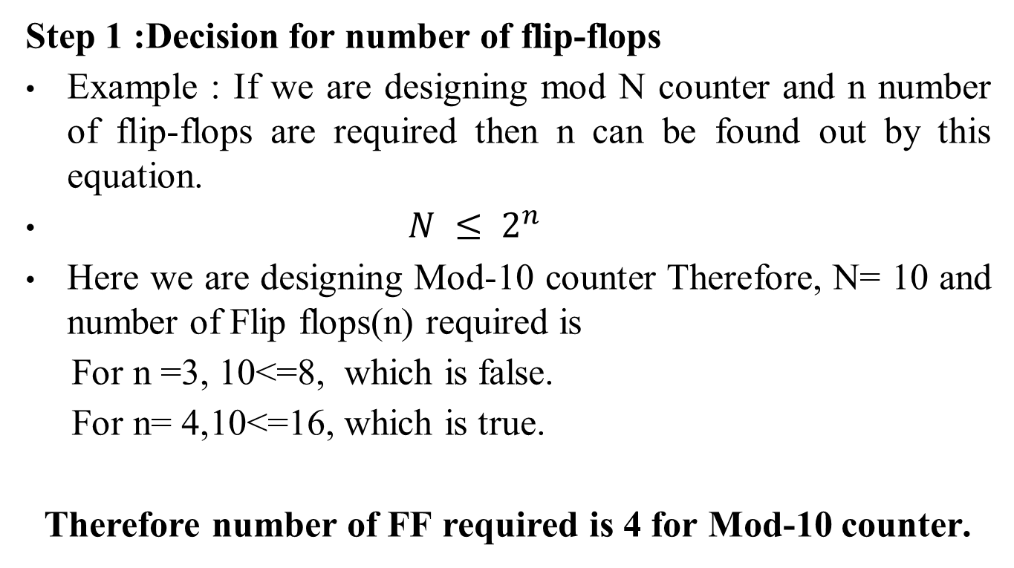
Step 1
Step 1 :Decision for number of flip-flops
Example : If we are designing mod N counter and n number of flip-flops are required then n can be found out by this equation.
$N ≤ 2^{n}$
Here we are designing Mod-10 counter Therefore, N= 10 and number of Flip flops(n) required is
For n =3, 10<=8, which is false.
For n= 4,10<=16, which is true.
Therefore number of FF required is 4 for Mod-10 counter.

Slide 7
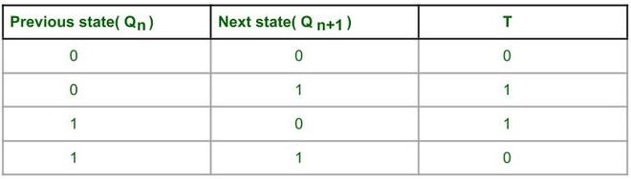
Step 2
Step 2 : Write excitation table of Flip flops.
Here T FF is used.
Excitation table of T FF.

Slide 8
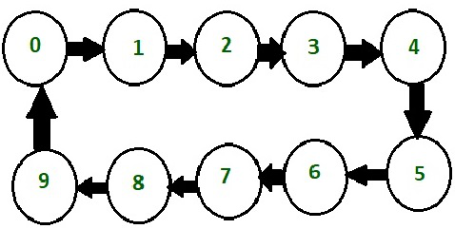
Step 3
Step 3 : Draw state diagram and circuit excitation table.
Counting Sequence of Decade counter
A decade counter is called as mod -10 or divide by 10 counter. It counts from 0 to 9 and again reset to 0. It counts in natural binary sequence. Here 4 T Flip flops are used. It resets after Q3 Q2 Q1 Q0 = 1001.

Slide 9
Continue…
Circuit excitation table:
Here Q₃ Q₂ Q₁ Q₀ are present states of four flip-flops and Q*₃ Q*₂ Q*₁ Q*₀ are next counting state of 4 Flip flops. If there is a transition in current state i.e if Q3 value changes from 0 to 1 or 1 to 0 then there’s corresponding T(toggle) bit is written as 1 otherwise 0.

Slide 10
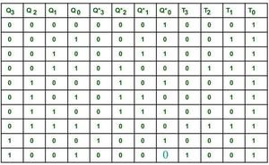
Continue…
Circuit excitation table

Slide 11
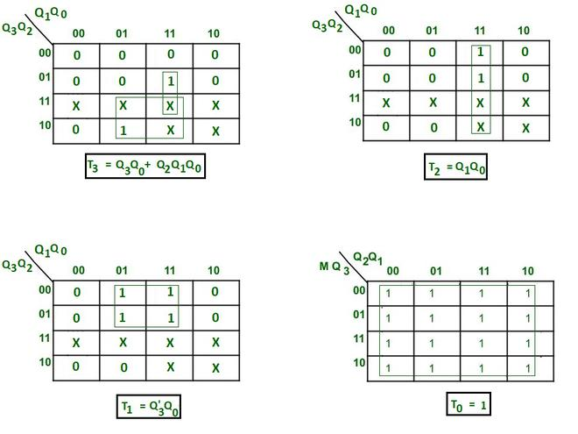
Step 4
Step 4 : Create Karnaugh map for each FF input in terms of flip-flop outputs as the input variable.
Simplify the K map –

Slide 12
Step 5
Step 5 : Create circuit diagram
Here negative edge triggered clock is used for toggling purpose. The clock is provided to every Flip flop at same instant of time. The toggle(T) input is provided to every Flip flop according to the simplified equation of K map.

Slide 13
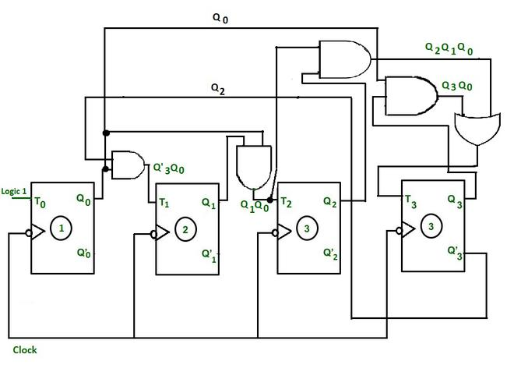
Continue…
Circuit diagram

Slide 14
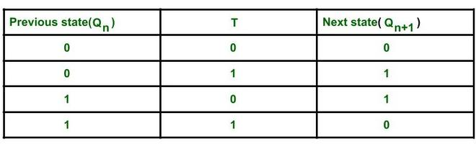
Continue…
Timing diagram : Here toggling is used.
Characteristic table of T FF.

Slide 15
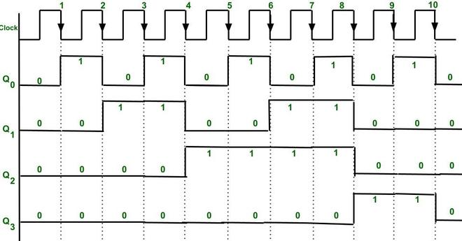
Continue…
The state of a FF will change only when toggle input(T) of a FF is 1.
Timing diagram of synchronous Decade counter

Slide 16
Continue…
Explanation :
Initially Q3 Q2 Q1 Q0 are 0 0 0 0.
The sequence of counter can be verified from the timing diagram. At every falling edge of the clock output Q₀ toggles because T₀ is connected to logic 1.
T₁ becomes 1 only when expression T1 = Q’₃Q₀ becomes 1 also if clock falling edge occurs(because there is negative edge triggering) then the output state of T₁ i.e Q₁ will change.
T₂ becomes 1 only when expression T2 = Q₁Q₀ becomes 1 also if clock falling edge occurs then the output state Q2 will change.

Slide 17
Continue…
T₃ becomes 1 only when expression T1 = Q₃Q₀ + Q₂Q₁Q₀ resultant becomes 1 also if clock falling edge occurs(because there is negative edge triggering) then the state of Q3 will change.
We get Output as Q₃(MSB) Q₂ Q₁ Q₀(LSB).
After 10th falling edge the output state of all the FFs again becomes 0 0 0 0.

